Slide 1
Restoring Trust by Computing: Data-driven Fact-checking and Exceptional Fact Finding
Chengkai Li
Professor and Associate Chair
Director, Innovative Database and Information Systems (IDIR) Lab
CSE Department, UT-Arlington
Texas Health Resources
August 29, 2019

Slide 2
Outline
A Brief History of Our Computational Journalism Research
Computational Journalism
Data-driven fact-checking (ClaimBuster)
Other ongoing fact-checking projects
Exceptional fact finding (FactWatcher, Maverick)
Graph Data Usability (Orion, GQBE, TableView, Maverick)

Slide 3
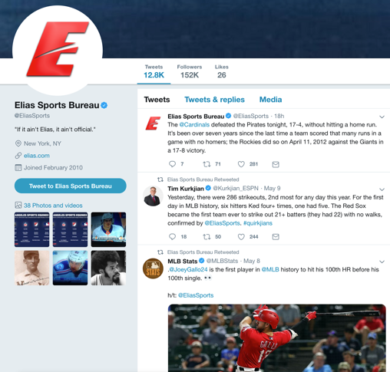
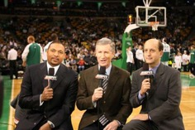

How it Started
Chris Paul had 16 points, 10 rebounds, 13 assists and five steals…… The only other active player to have such a game is Jason Kidd…
2009
How did they come up with that?

Slide 4
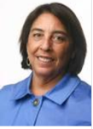
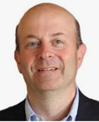
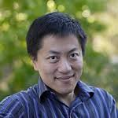
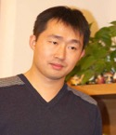
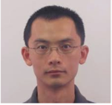
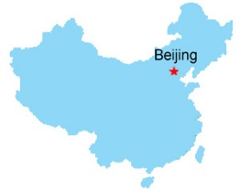


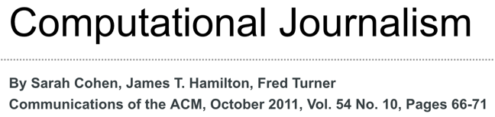
How it Started
“Developing the Field of Computational Journalism” Workshop, July 27-31, 2009
Let’s work on this fact-finding problem.
This is computational journalism.
Summer 2010
#@%&!#!%

Slide 5

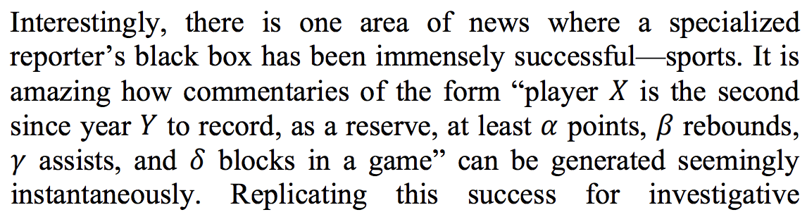
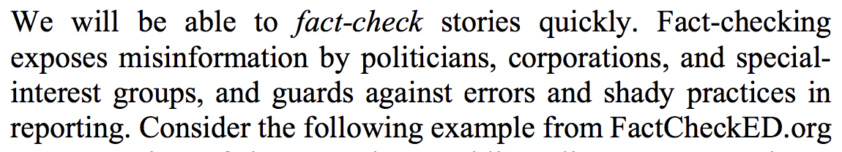
CIDR 2011
fact-finding
fact-checking

Slide 6
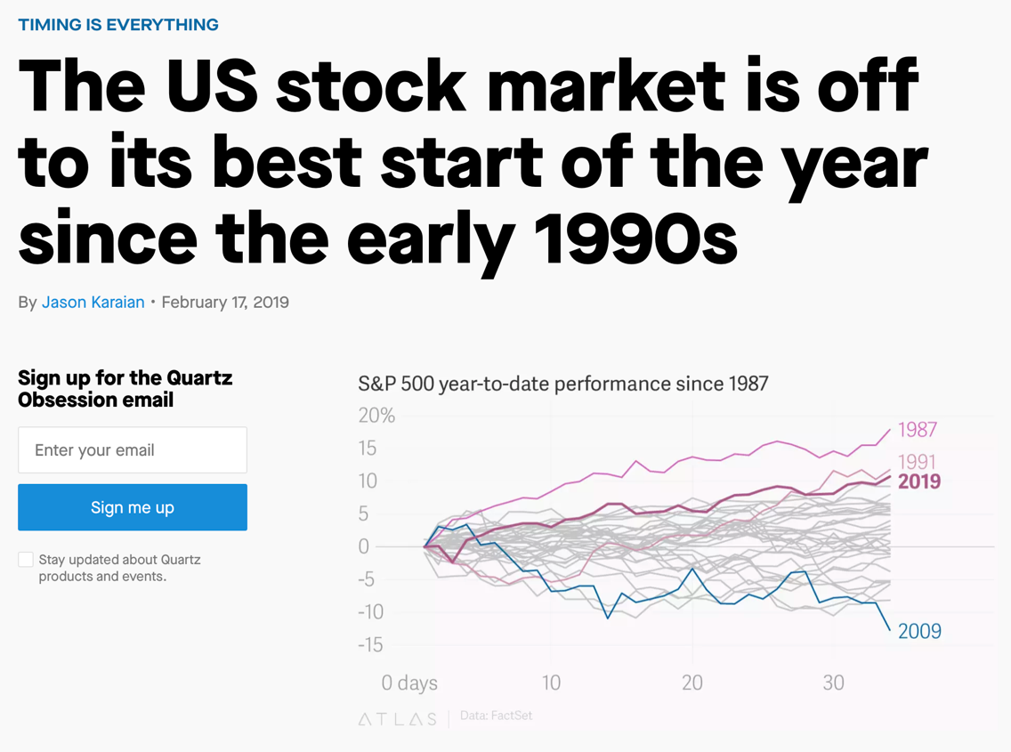

Slide 7
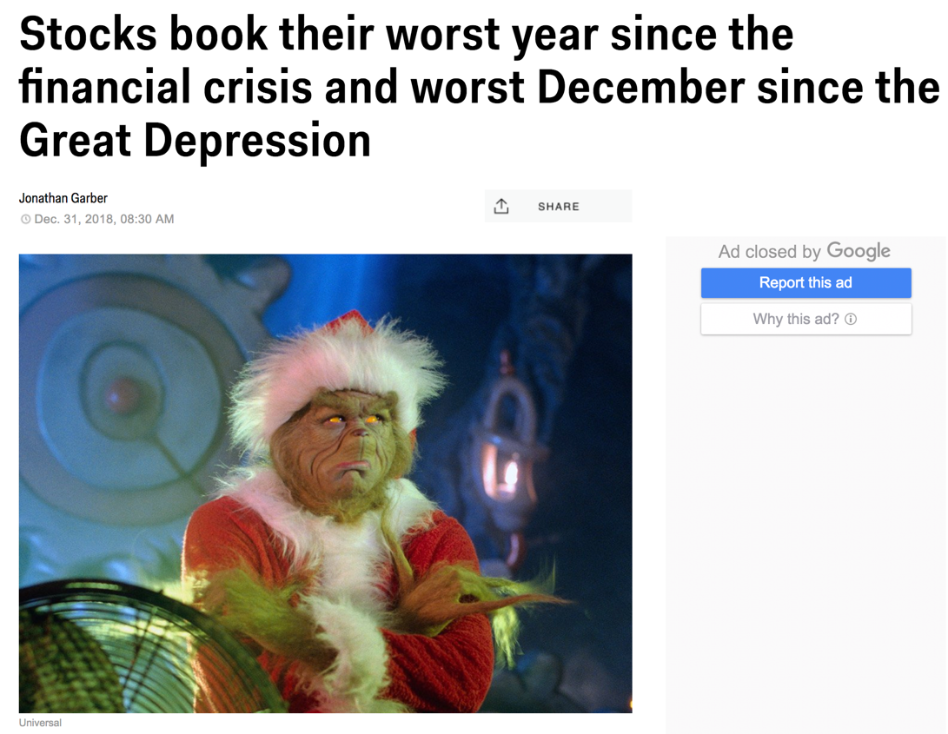

Slide 8
The “Fake News” Problem
It was always there, since “Yellow Journalism” started in 1890s.
Exaggerated headlines, clickbait, computational propaganda, misinformation, disinformation
Snopes.com (1994), Glenn Kessler (1996), FactCheck.org (2003), PolitiFact (2007)
But it became a daily talking point since 2016.
Pizzagate
“filter bubble” and “echo chamber” exacerbated by social media
The many false claims in political discourses
Russian meddling with U.S. election
Twitter bots, Facebook ads, trendy topic algorithms

Slide 9
Outline
A Brief History of our Computation + Journalism Research
Computational Journalism
Data-driven fact-checking (ClaimBuster)
Other ongoing fact-checking projects
Exceptional fact finding (FactWatcher, Maverick)
Graph Data Usability (Orion, GQBE, TableView, Maverick)

Slide 10


Toward the Holy Grail of Automated Fact-checking
idir.uta.edu/claimbuster
10

Slide 11
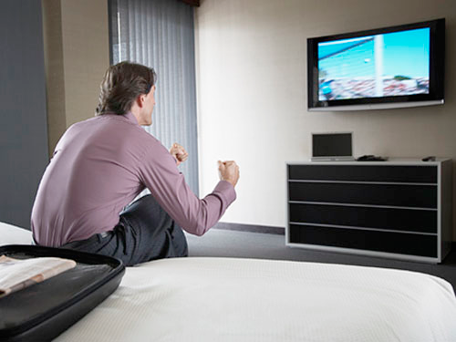
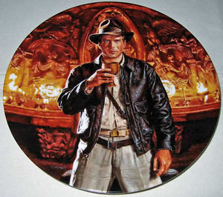
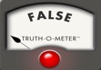

The Holy Grail: Automated, Live Fact-Checking
Source: Bill Adair

Slide 12
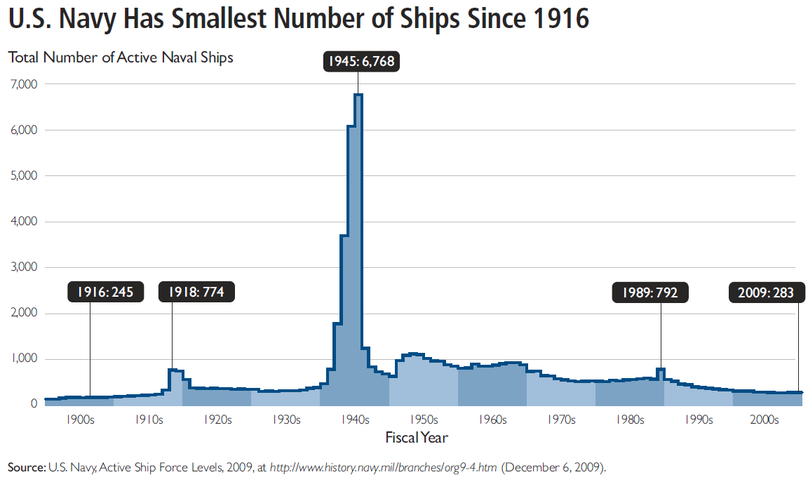
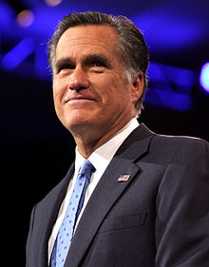
Fact-checking is Hard
“… our Navy is smaller than it's been since 1917", said Republican candidate Mitt Romney in third presidential debate in 2012.
http://en.wikipedia.org/wiki/Mitt_Romney
http://s3.amazonaws.com/thf_media/2010/pdf/Military_chartbook.pdf

Slide 13
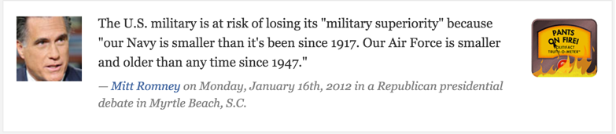

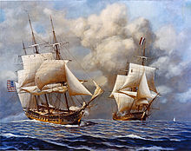
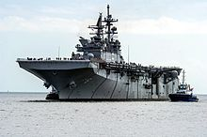
Fact-checking is Hard
“… our Navy is smaller than it's been since 1917", said Republican candidate Mitt Romney in a Republican presidential debate in 2012.
vs
http://en.wikipedia.org/wiki/Mitt_Romney
http://s3.amazonaws.com/thf_media/2010/pdf/Military_chartbook.pdf
http://en.wikipedia.org/wiki/United_States_Navy

Slide 14
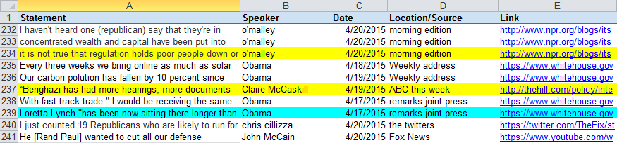
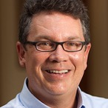
PolitiFact “Buffet” of Factual Claims

Slide 15





Finding Important Factual Claims:
A Supervised Learning Task
2016
Presidential
Debates
Human Annotation
Feature Extraction
Learning Algorithm
Ground Truth
Feature Vectors
Presidential Debate Transcripts (1960-2012)
Important factual claims
15

Slide 16
Classification and Ranking by Check-worthiness
CFS: Important factual claims
“We spend less on the military today than at any time in our history.” “The President’s position on gay marriage has changed.” “More people are unemployed today than four years ago.”
UFS: Unimportant factual claims
“I was in Iowa yesterday.” “My mother enjoys cooking.” “I ran for President once before.”
NFS: No factual claims (opinions, questions & declarations)
“Iran must not get nuclear weapons.” “7% unemployment is too high.” “My opponent is wishy-washy.” “I will be tough on crime.” "Why should we do that?“ “Hello, New Hampshire!” “Our plan is to reduce tax rate by 10%.”
16

Slide 17
Our Own CrowdFlower
17

Slide 18
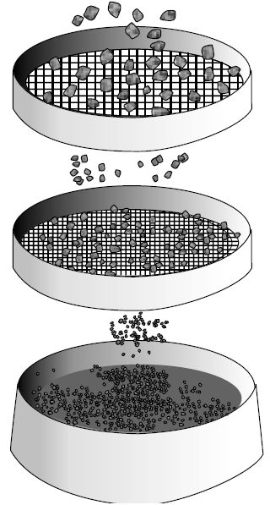
Ground Truth Collection
20788 sentences
374 coders
76552 labels
20 months, 374 coders, ~$4,000 paid
30 training sentences
1032 screening sentences (731 NFS, 63 UFS, 238 CFS) to detect spammers & low-quality coders
86 top-quality coders
52333 labels
Class | Count | Percentage
CFS | 4849 | 23.52%
UFS | 2097 | 10.17%
NFS | 13671 | 66.31%
Majority voting
20617 admitted sentences
http://www.engineersdaily.com/2014/03/basics-of-soil-compaction.html
18

Slide 19
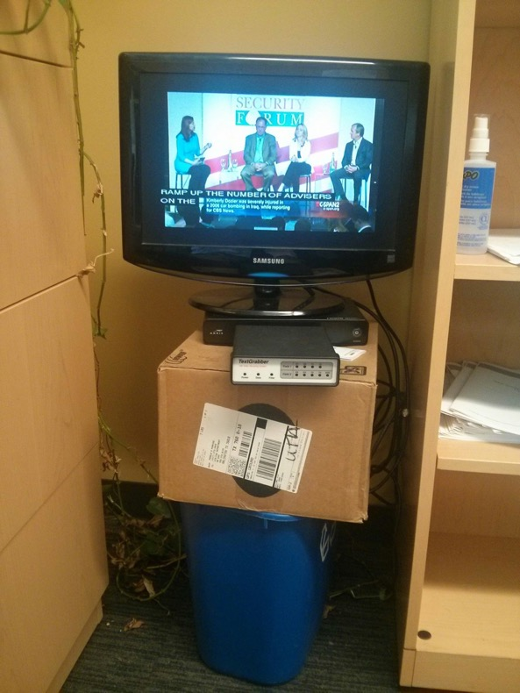
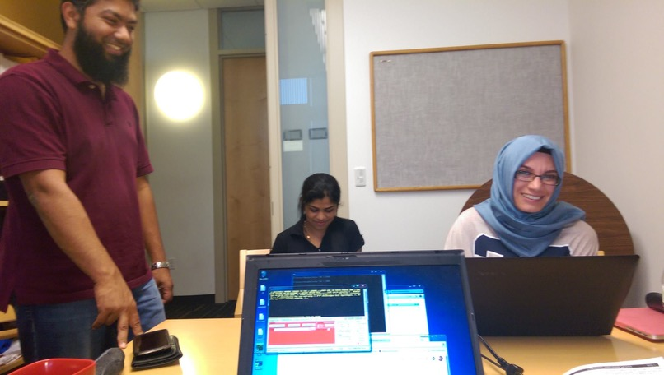

Slide 20
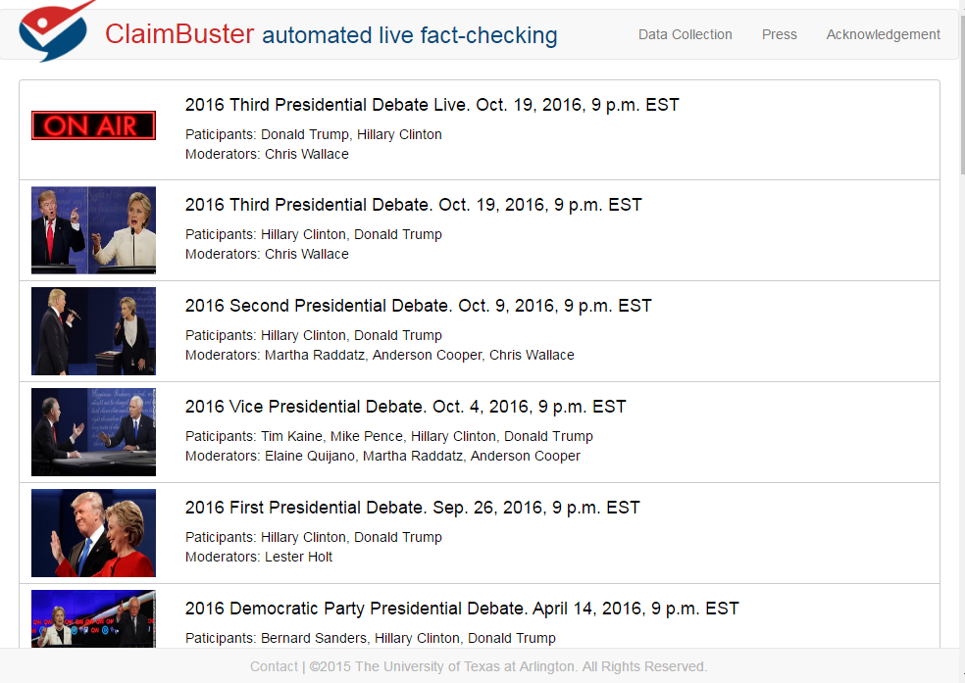
20

Slide 21
LSTM-based Model for Claim Spotting
Model based on an LSTM (long short-term memory) network
Tested several different word embeddings but found no significant difference in overall performance
Different embeddings did have different affinities (i.e., some produce models which score text with numbers higher on average).
We used nonsensical sentences to make the model more resistant to attacks. The neural models outperformed the SVM model by 29% in precision and 12% in recall.

Slide 22
Adversarially Trained LSTM
Training the LSTM model on adversarial (modified) examples.
Adversarial noise (perturbations), designed to maximize the chance of misclassification by the network, was calculated using back-propagation.
Perturbation was applied to word-embeddings rather than directly to the input.

Slide 23
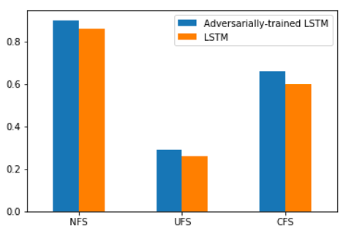
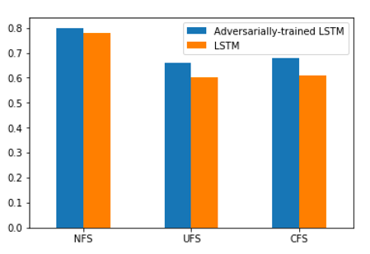
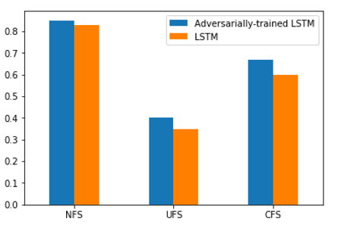
Adversarially Trained LSTM
Recall
Precision
F1-score

Slide 24
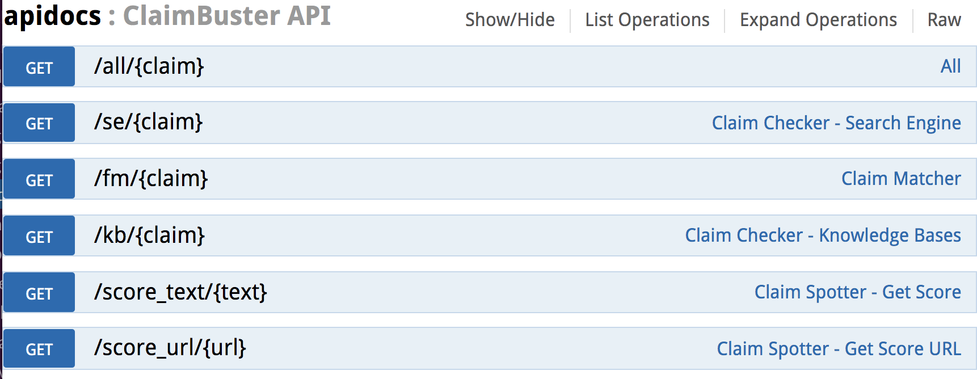
ClaimBuster API

Slide 25
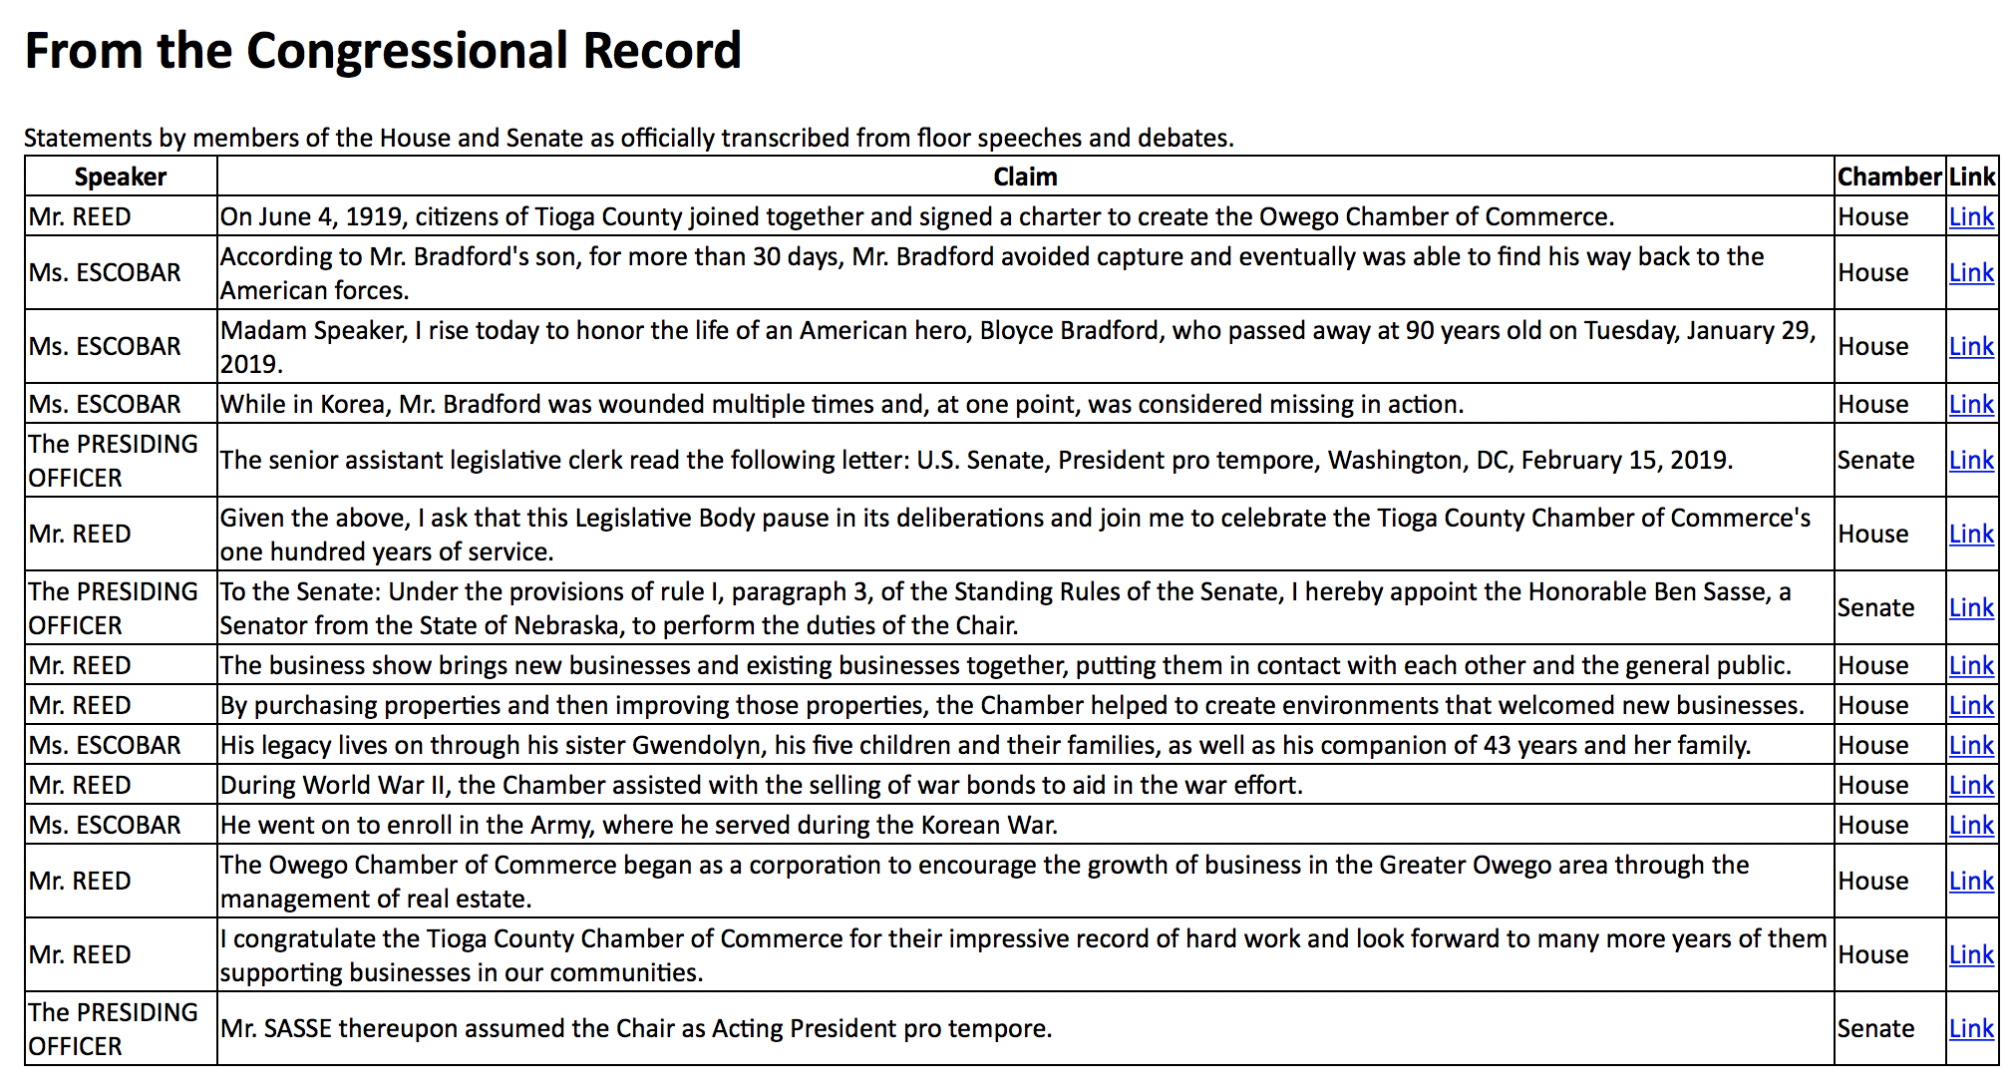
PolitiFact “Buffet” of Factual Claims

Slide 26
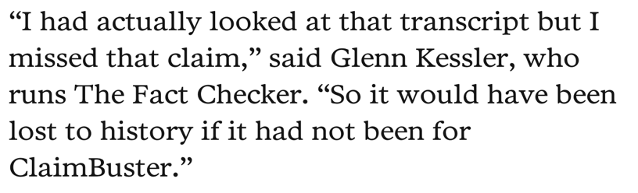
Duke Reporters’ Lab uses ClaimBuster API in creating daily newsletters that recommend to The Washington Post, New York Times, PolitiFact, and other fact-checkers the most check-worthy claims in CNN programs, Tweets, Facebook ports, and the Congressional Record.

Slide 27

Claim Spotter
27

Slide 28

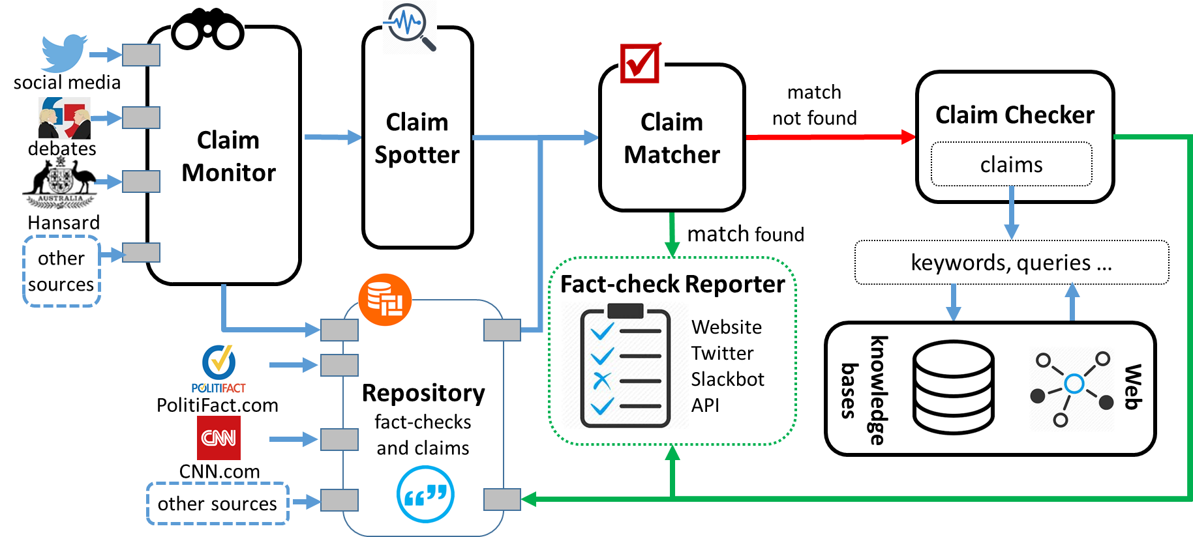
The First-ever End-to-end Fact-checking System
[CIKM15a, KDD17, VLDB17demo, IJCNN18]
* First Runner-Up, SIGMOD17 Student Research Competition
28

Slide 29
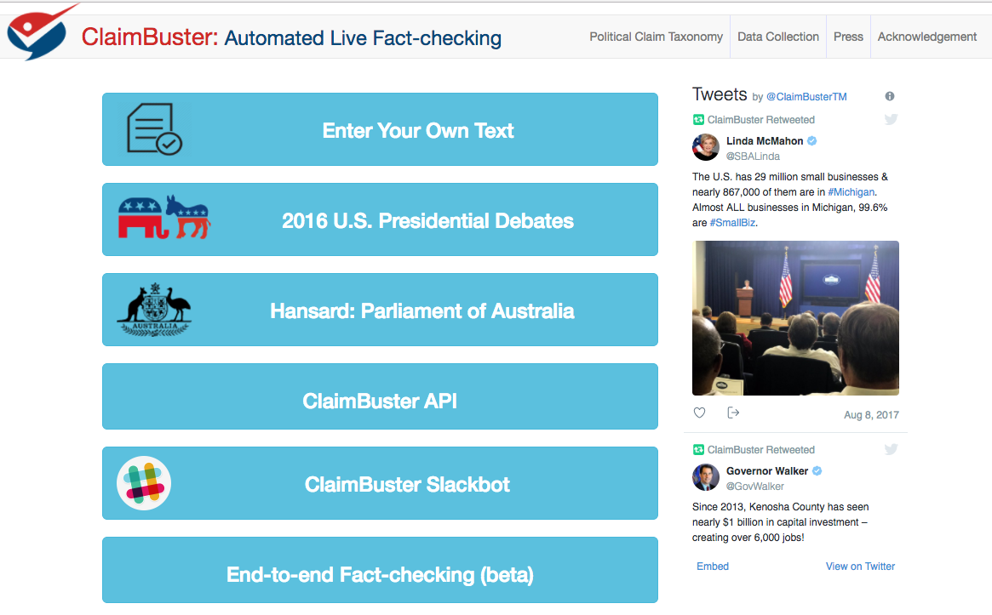
29

Slide 30
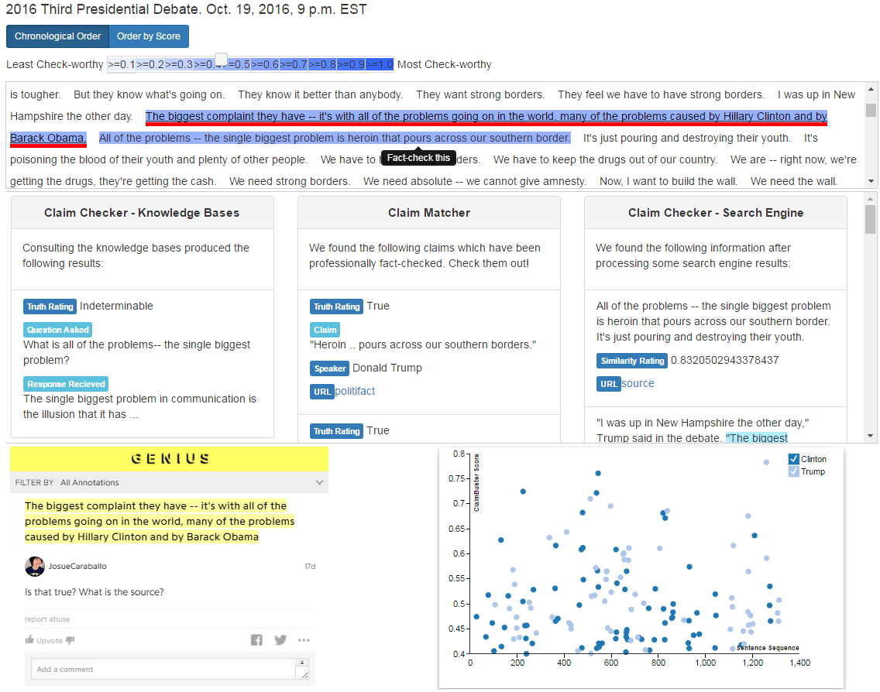
30

Slide 31
Outline
A Brief History of our Computation + Journalism Research
Computational Journalism
Data-driven fact-checking (ClaimBuster)
Other ongoing fact-checking projects
Exceptional fact finding (FactWatcher, Maverick)
Graph Data Usability (Orion, GQBE, TableView, Maverick)

Slide 32
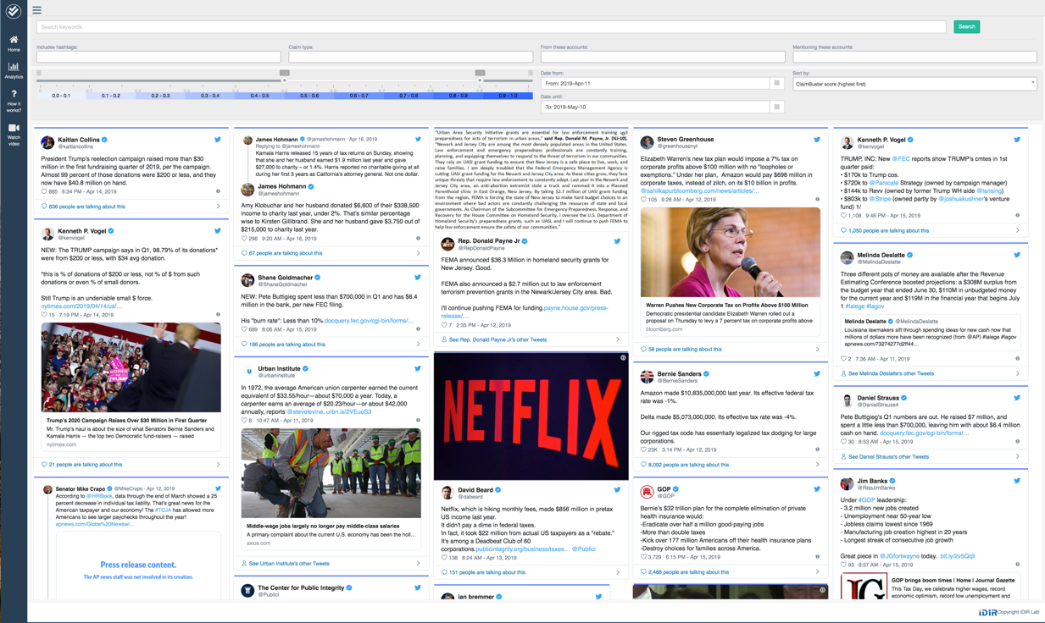
ClaimPortal: Integrated Monitoring, Searching, Checking, and Analytics of Factual Claims on Twitter
https://idir.uta.edu/claimportal/

Slide 33
Outline
A Brief History of our Computation + Journalism Research
Computational Journalism
Data-driven fact-checking (ClaimBuster)
Other ongoing fact-checking projects
Exceptional fact finding (FactWatcher, Maverick)
Graph Data Usability (Orion, GQBE, TableView, Maverick)

Slide 34
How it Started
Chris Paul had 16 points, 10 rebounds, 13 assists and five steals…… The only other active player to have such a game is Jason Kidd…
2009
How did they come up with that?

Slide 35
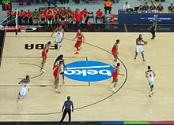
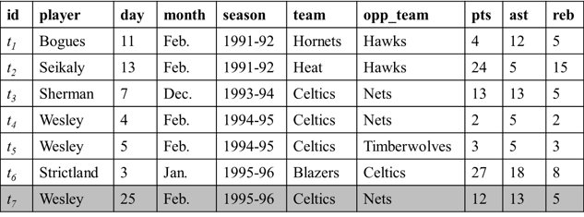
Exceptional Fact Finding
New tuple appended to database
Real-world event (sports, transportation, crime, weather, finance, social media)
Wesley had 12 points, 13 assists and 5 rebounds on February 25, 1996 to become the first player with a 12/13/5 (points/assists/rebounds) in February.
Fact-finding algorithms
Number-based facts make news stories more engaging
http://en.wikipedia.org/wiki/Basketball

Slide 36
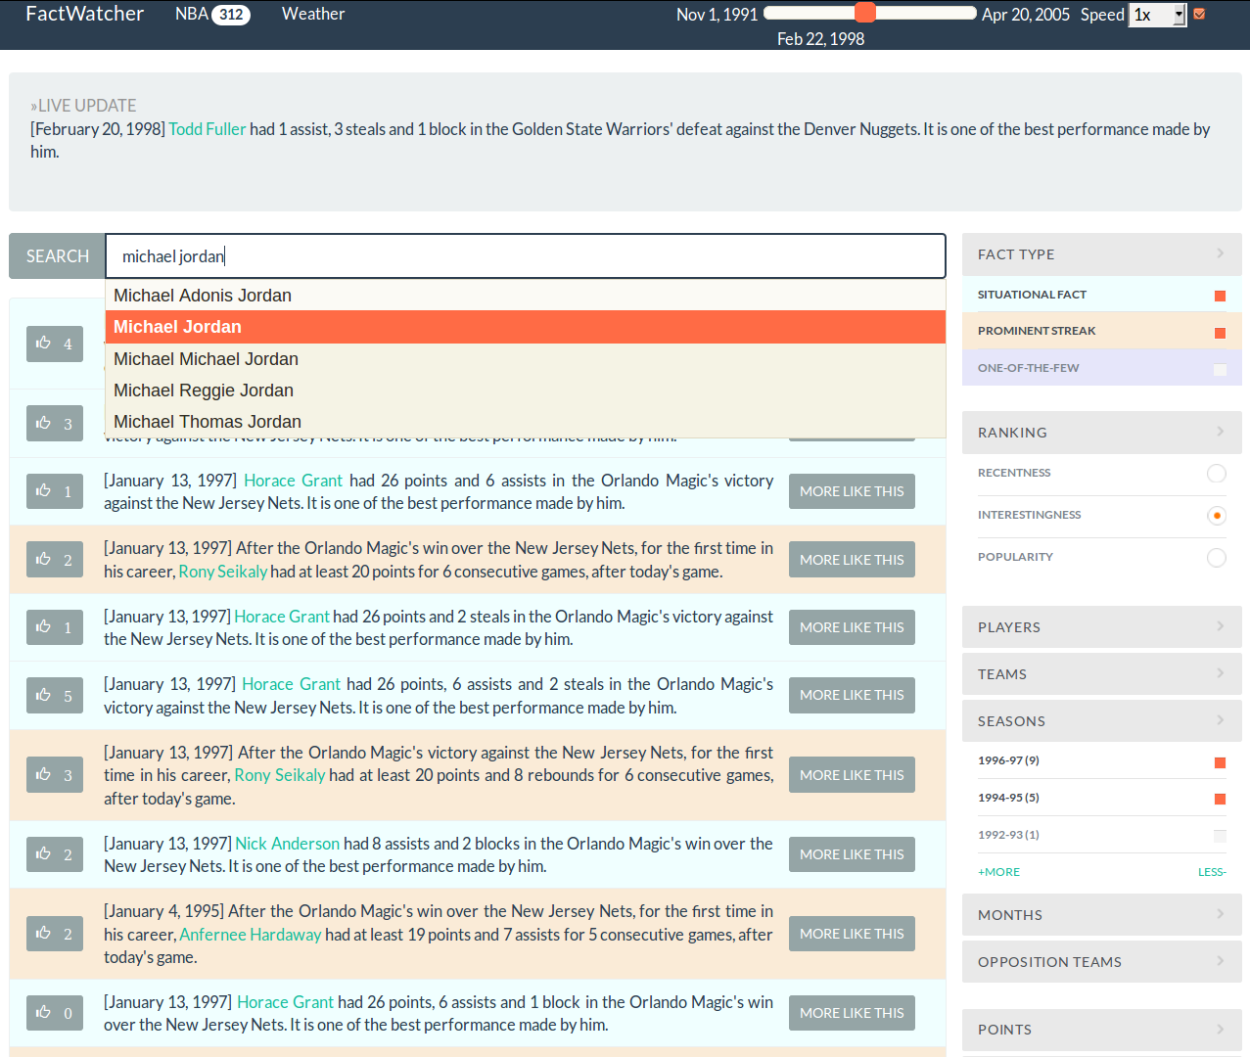

Excellent
Demo Award
idir.uta.edu/factwatcher

Slide 37
Fact-finding Algorithms
FactWatcher [VLDB14 demo]
[ICDE14] Situational Facts: “No other player scored more pts and reb against DAL than Jordan.”
[KDD12] One-of-the-Few: “Jordan scored 10 pts & 10 reb. Only 3 others had similar performance.”
[KDD11] Prominent Streaks: “The Nikkei 225 closed below 10000 for the 12th consecutive week, the longest such streak since June 2009.”
[TKDD14] General Prominent Streaks: “James has scored at least 20 points and handed out 10 or more assists in each of his last five games against the Hawks, the longest streak he has ever had against one team.”
Frequent Episode Mining [ICDE15]

Slide 38
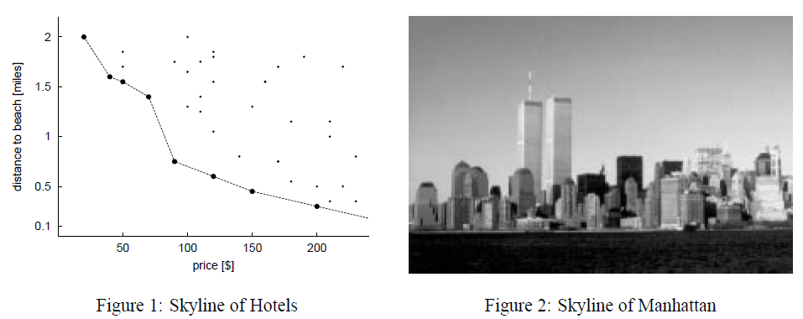
Fact-finding Algorithms
Many interesting facts in the real-world can be modeled as various types of skyline points.
The gist of fact-finding is to efficiently, incrementally maintain skyline points over ever-changing data, while considering constraints such as selection conditions.
Stephan Börzsönyi, Donald Kossmann, Konrad Stocker: The Skyline Operator. ICDE 2001: 421-430

Slide 39
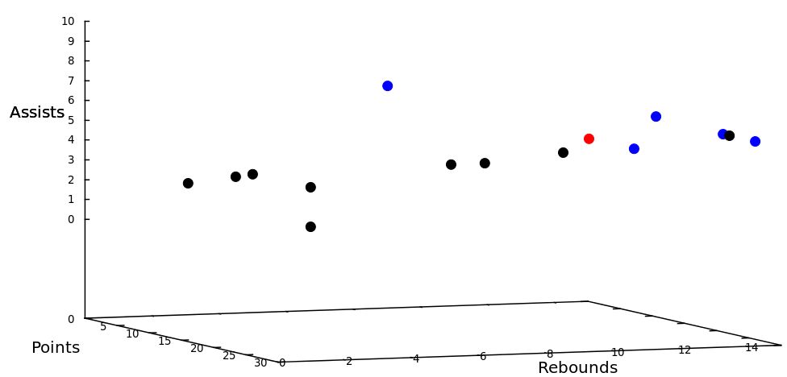
Modeling Situational Facts
“Paul George had 21 points, 11 rebounds and 5 assists to become the first Pacers player with a 20/10/5 (points/rebounds/assists) game against the Bulls since Detlef Schrempf in December 1992.”
(http://espn.go.com/espn/elias?date=20130205)

Slide 40
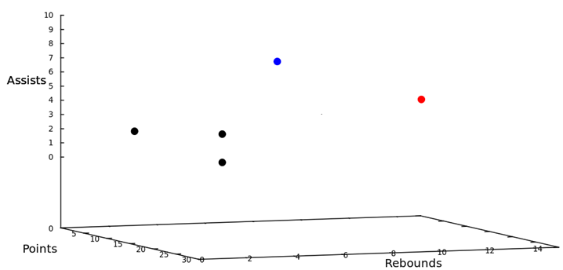
Modeling Situational Facts
“Paul George had 21 points, 11 rebounds and 5 assists to become the first Pacers player with a 20/10/5 (points/rebounds/assists) game against the Bulls since Detlef Schrempf in December 1992.”
(http://espn.go.com/espn/elias?date=20130205)

Slide 41
Modeling Situational Facts
Dimension space: D={d₁,… ,d_{n}}
Measure space: M ={m₁,… ,m_{s}}
id | player | day | month | season | team | opp_team | pts | ast | reb
t₁ | Bogues | 11 | Feb. | 1991-92 | Hornets | Hawks | 4 | 12 | 5
t₂ | Seikaly | 13 | Feb. | 1991-92 | Heat | Hawks | 24 | 5 | 15
t₃ | Sherman | 7 | Dec. | 1993-94 | Celtics | Nets | 13 | 13 | 5
t₄ | Wesley | 4 | Feb. | 1994-95 | Celtics | Nets | 2 | 5 | 2
t₅ | Wesley | 5 | Feb. | 1994-95 | Celtics | Timberwolves | 3 | 5 | 3
t₆ | Strictland | 3 | Jan. | 1995-96 | Blazers | Celtics | 27 | 18 | 8
Τ
Skyline maintenance + Data Cube/OLAP
a₁
b₁
c₁
a₁,b₁
a₁,c₁
b₁,c₁
a₁,b₁,c₁

Slide 42
Outline
A Brief History of our Computation + Journalism Research
Computational Journalism
Data-driven fact-checking (ClaimBuster)
Other ongoing fact-checking projects
Exceptional fact finding (FactWatcher, Maverick)
Graph Data Usability (Orion, GQBE, TableView, Maverick)

Slide 43
Tackling Graph Data Usability Challenges
Challenges
Massive, complex graphs; millions of entities; billions of edges.
Requires substantial understanding of schema and data and complex pre-processing, before one can fetch information or gain insights from data.
Objectives
Make it easy to understand, query, explore, and clean graph data.
Systems
GQBE [TKDE15, ICDE14demo]: graph query by example
Orion [VLDB15demo, SIGMOD17tutorial]: auto-suggestion for interactive query formulation
TableView [SIGMOD16, ICDE18demo]: generating preview tables for knowledge graphs
( * SIGMOD Most Reproducible Paper Award)
Maverick [SIGMOD18, VLDB18demo]: finding outliers and errors in graphs

Slide 44

IDIR Projects and Demos
Demonstration Videos https://vimeo.com/channels/1024406
ClaimBuster (idir.uta.edu/claimbuster) Automated, live fact-checking
ClaimPortal (idir.uta.edu/claimportal) Monitoring factual-claims on social media
CrewScout (idir.uta.edu/crewscout) Expert team finding by skyline groups
ERQ: Entity-Relationship Query (idir.uta.edu/erq) Structured query on Wikipedia
Facetedpedia (idir.uta.edu/facetedpedia) Faceted search interface for Wikipedia
FactWatcher (idir.uta.edu/factwatcher) Fact-finding from real-world events
FrameAnnotator (idir.uta.edu/frameannotator) Frame annotation tool
GQBE (idir.uta.edu/gqbe) Graph query by example
Orion (idir.uta.edu/orion) Auto-suggestion for interactive graph query formulation
TableView Generating preview tables for knowledge graphs
Maverick Exceptional fact finding from knowledge graphs
System idir.uta.edu/claimbuster
System idir.uta.edu/claimbuster

Slide 45
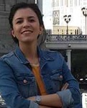
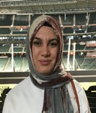




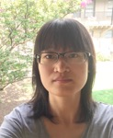
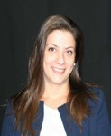




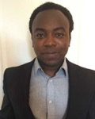
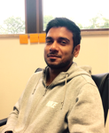


Current IDIR Students
Ph.D. students
Farahnaz
Akrami
Fatma
Arslan
Israa
Jaradat
Damian
Jimenez
Shadekur
Rahman
Samiul
Saeef
Xiao
Shi
Theodora
Toutountzi
Zeyu
Zhang
M.S. students
B.S. students
Priyank
Arora
Sumeet
Lubal
Sarthak
Majithia
Daniel
Obembe
Sarbajit
Roy
Kyrell
Dixon
Jacob
Devasier
System idir.uta.edu/claimbuster
System idir.uta.edu/claimbuster

Slide 46
Graduated Students
Ph.D. students
Aditya Telang
2011 (co-advised) IBM Research India
Ning Yan
2013
Research Scientist
Huawei, Santa Clara
Naeemul Hassan
2016
Assistant Professor
University of Mississippi
Nandish Jayaram
2016
Pivotal
Gensheng Zhang
2017
Google
Afroza Sultana
2018
Teradata Lab
B.S. students
M.S. Thesis students
Josue Caraballo (2017)
Damian Jimenez (2017, UTA Ph.D.)
Long Ly (2015)
Sidharth Goyal (2015)
Huadong Feng (2014)
Raju Karki (2012)
Angus Helm (2010)
Aakash Tuli (2010)
Tulsi Chandwani (2017, Red Hat)
Abu Ayub Ansari Syed (2017)
Ishwor Timilsina (2017, Fidelity)
Nigesh Shakya (2017)
Rohit Bhoopalam (2016, Akamai)
Fatma Dogan (2015, UTA Ph.D.)
Minumol Joseph (2015, Capital One)
Ramesh Venkataraman (2014, Amazon)
Mahesh Gupta (2012, Electronic Arts)
Jijo Philip (2012, Cerner Corporation)
Avinash Bharadwaj (2011, Copper Labs)
Quazi (Sunny) Hasan (2010, Dematic)
Jared Ashman (2010, Ambit Energy)
Muhammad Safiullah (2008, Microsoft)

Slide 47
Collaborators on Current and Past IDIR Projects
Bill Adair (Duke, Public Policy)
Pankaj Agarwal (Duke)
Xiang Ao (Chinese Academy of Sciences)
Vassilis Athitsos (UTA)
Sourav Bhowmick (Nanyang Technological University )
Sharma Chakravarthy (UTA)
Gong Cheng (Nanjing University)
Byron Choi (Hong Kong Baptist University)
Christoph Csallner (UTA)
Gautam Das (UTA)
Chris Ding (UTA)
Ramez Elmasri (UTA)
Leonidas Fegaras (UTA
Peter Fray (University of Technology Sydney, Journalism)
James Hamilton (Stanford, Communication)
Naeemul Hassan (Mississippi)
Wei Hu (Nanjing University)
Arijit Khan (Nanyang Technological University)
Angela Lee (UTD, Communication)
Zhiqiang Lin (Ohio State)
Ping Luo (Chinese Academy of Sciences)
Mark Stancel (Duke, Public Policy)
Mark Tremayne (UTA, Communication)
Min Wang (Google)
Xifeng Yan (UCSB)
Jun Yang (Duke)
Cong Yu (Google Research)
Nan Zhang (Penn State)

Slide 48






Funding Sponsors
Entrepreneurship

Slide 49
Thank you!

